Slide 1
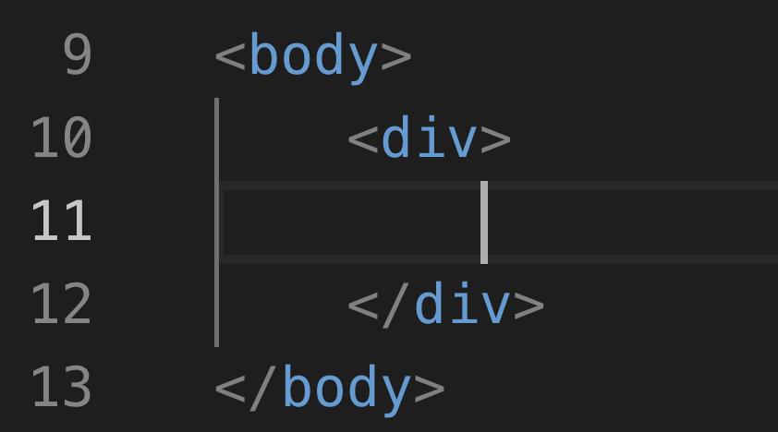

Slide 2
Web Layout

Slide 3
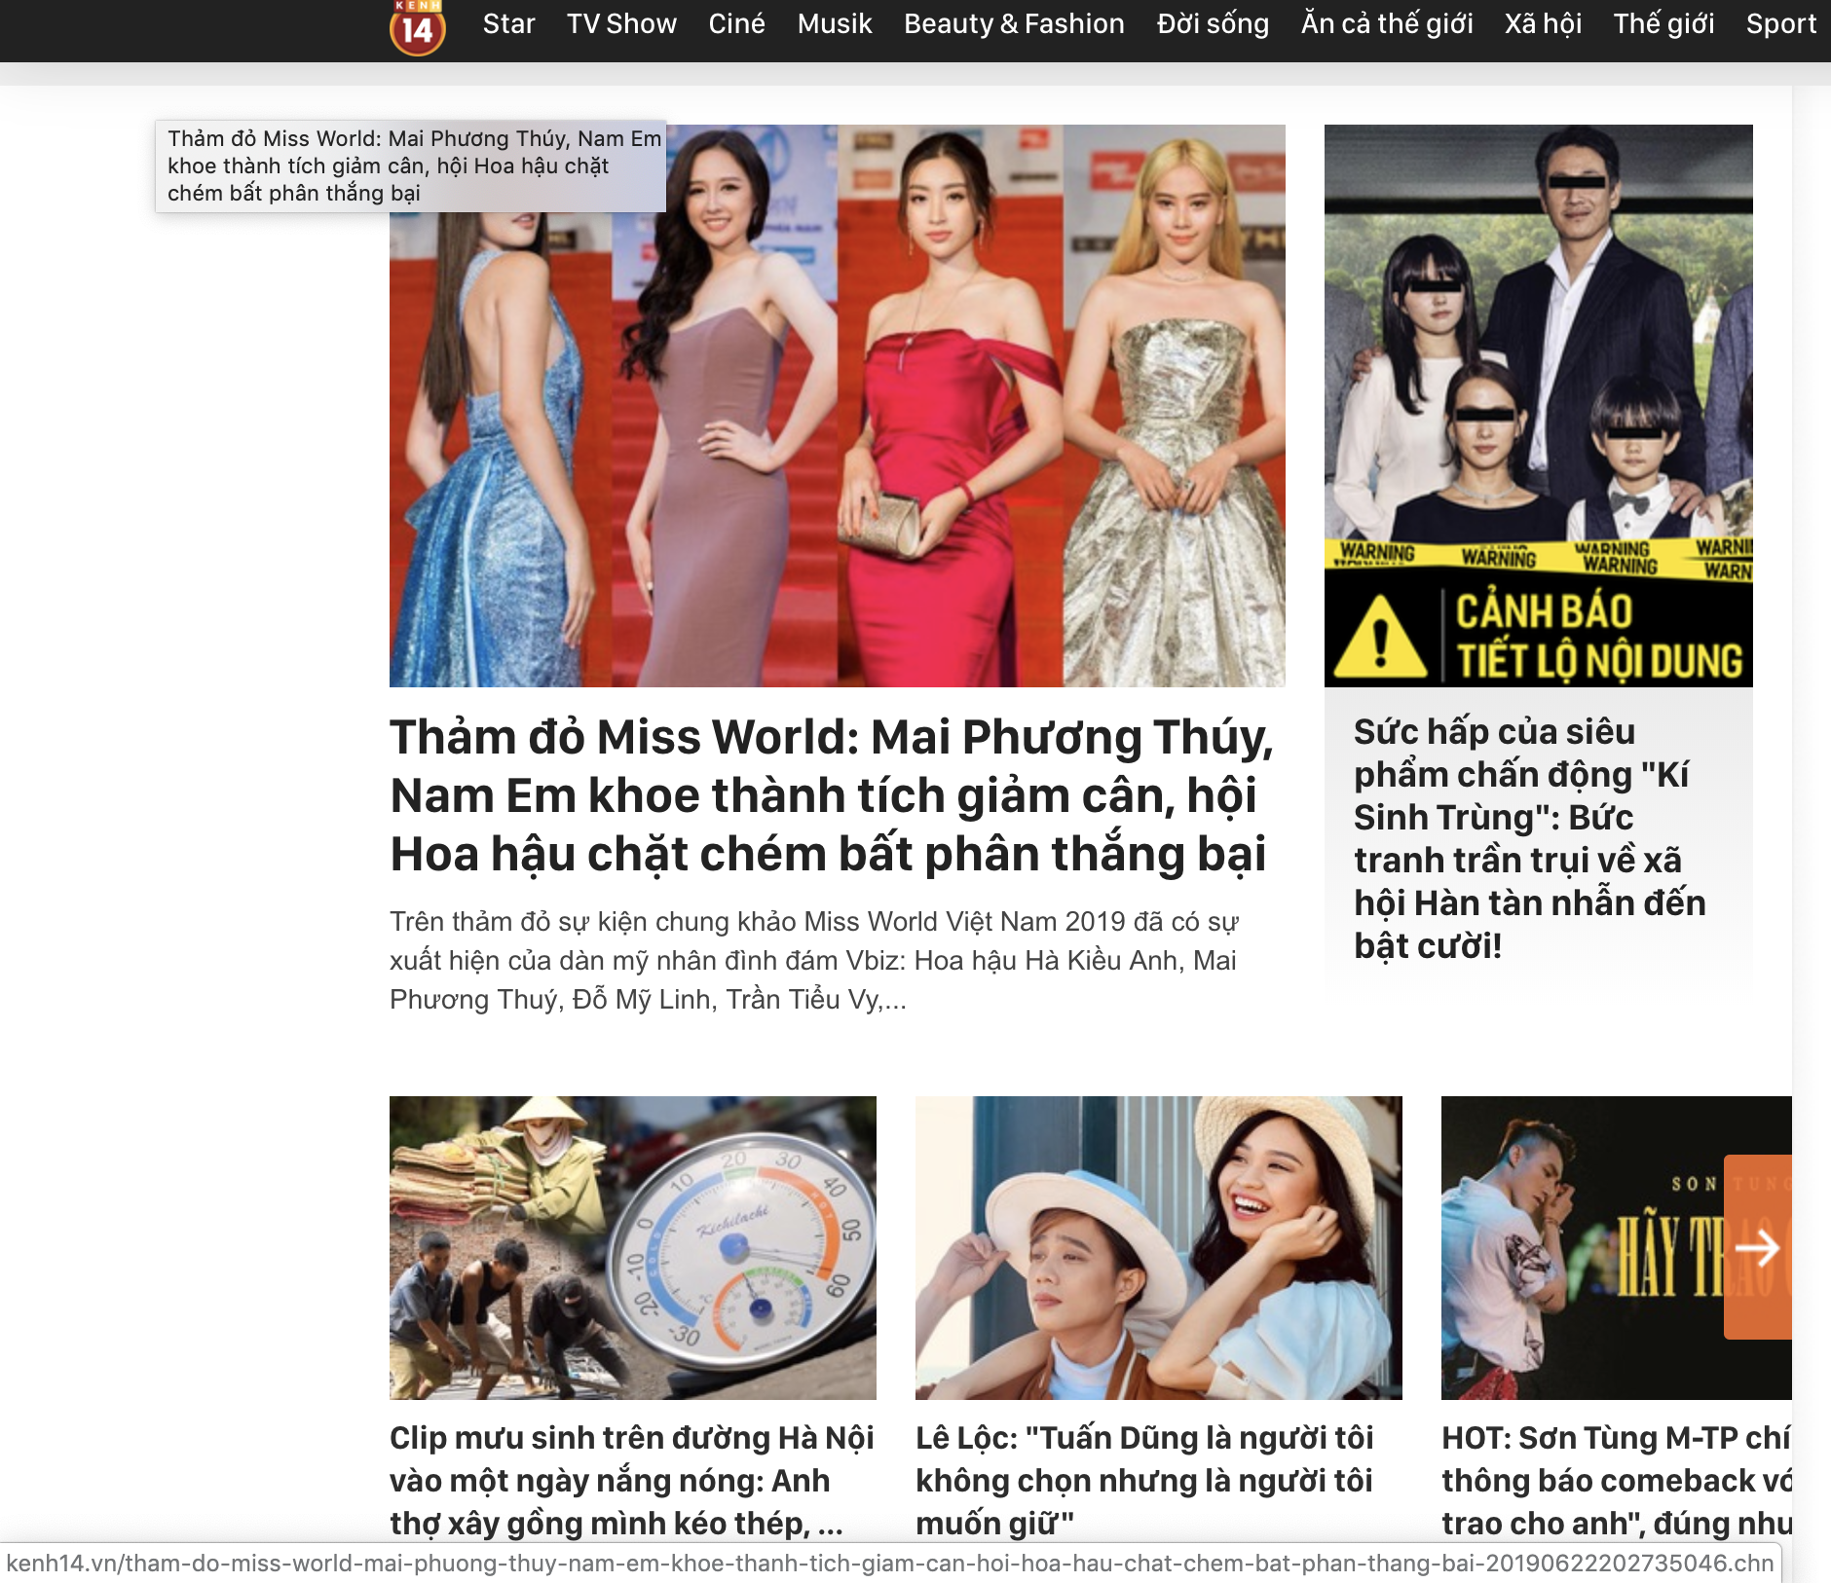
Kenh14.vn

Slide 5
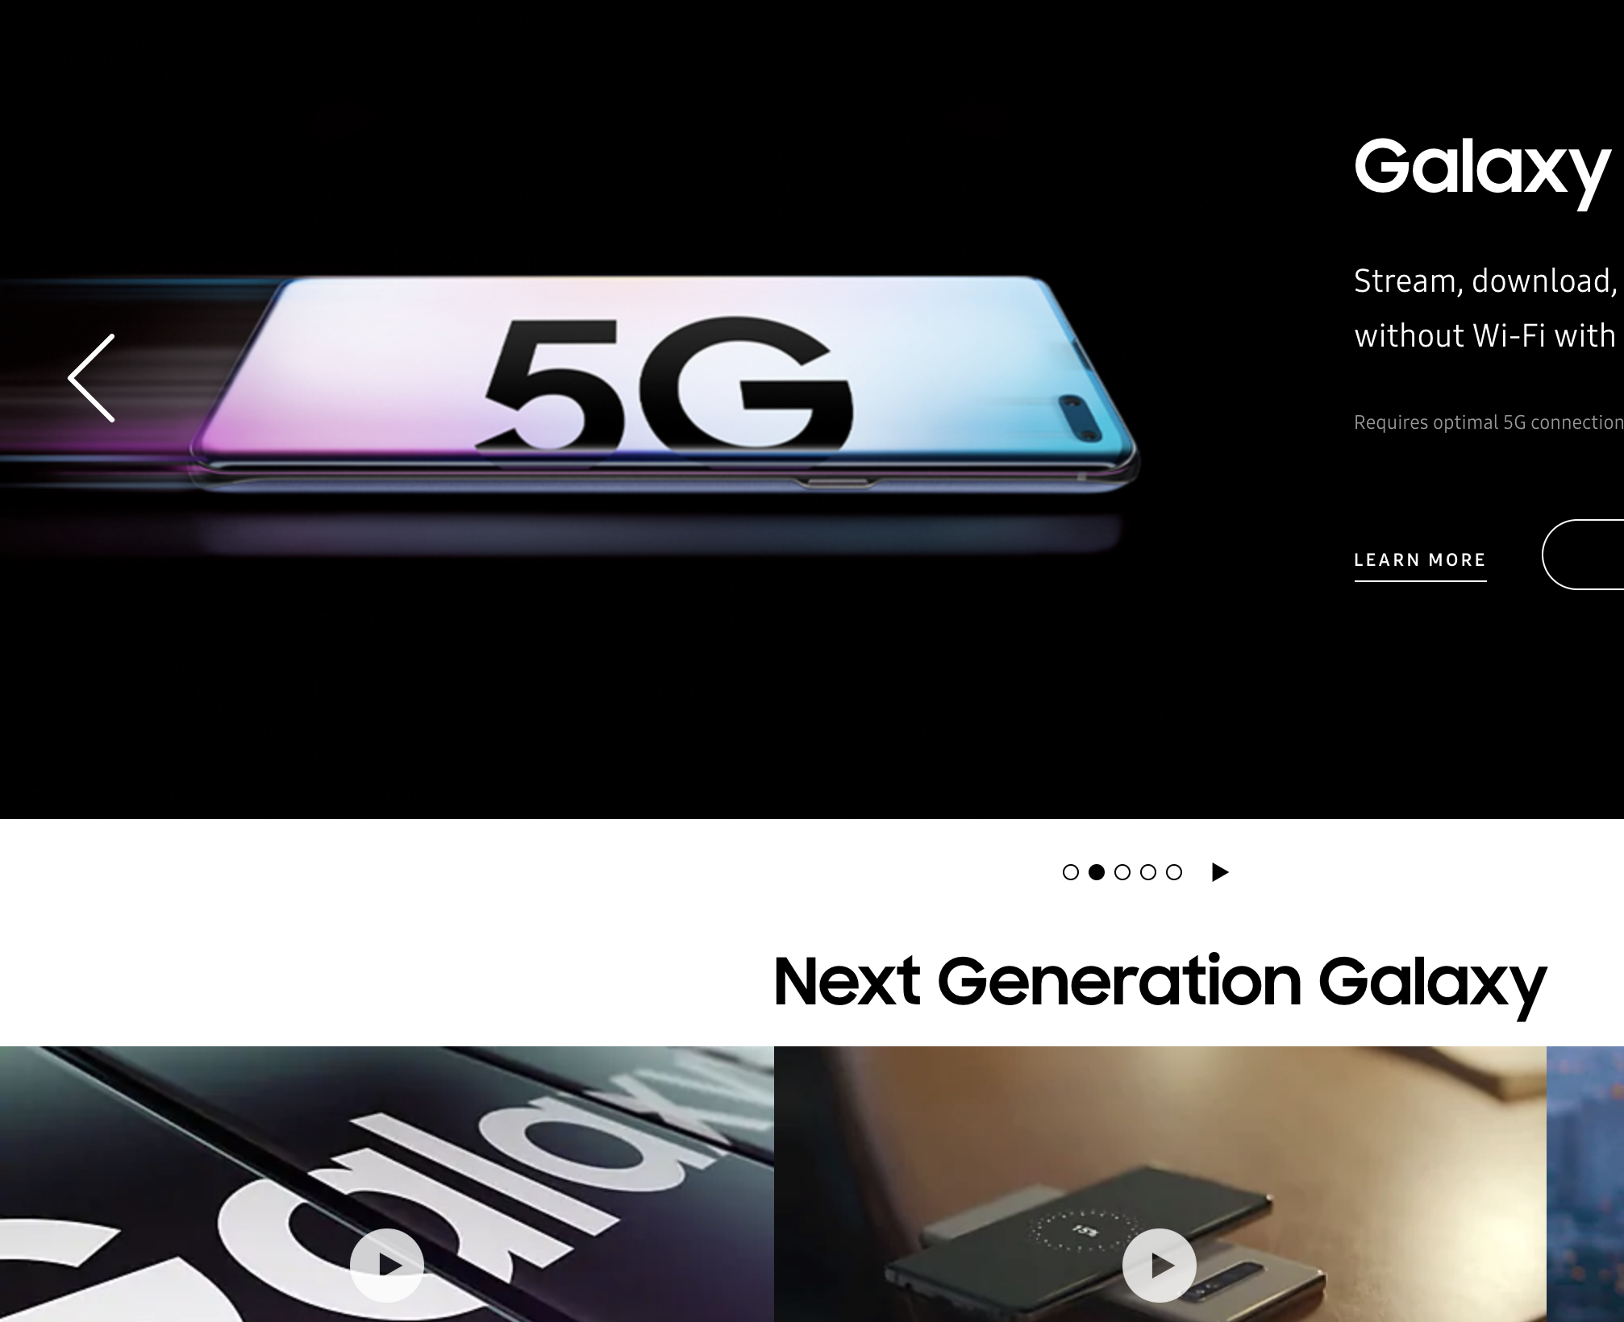
Samsung.com

